Slide 1
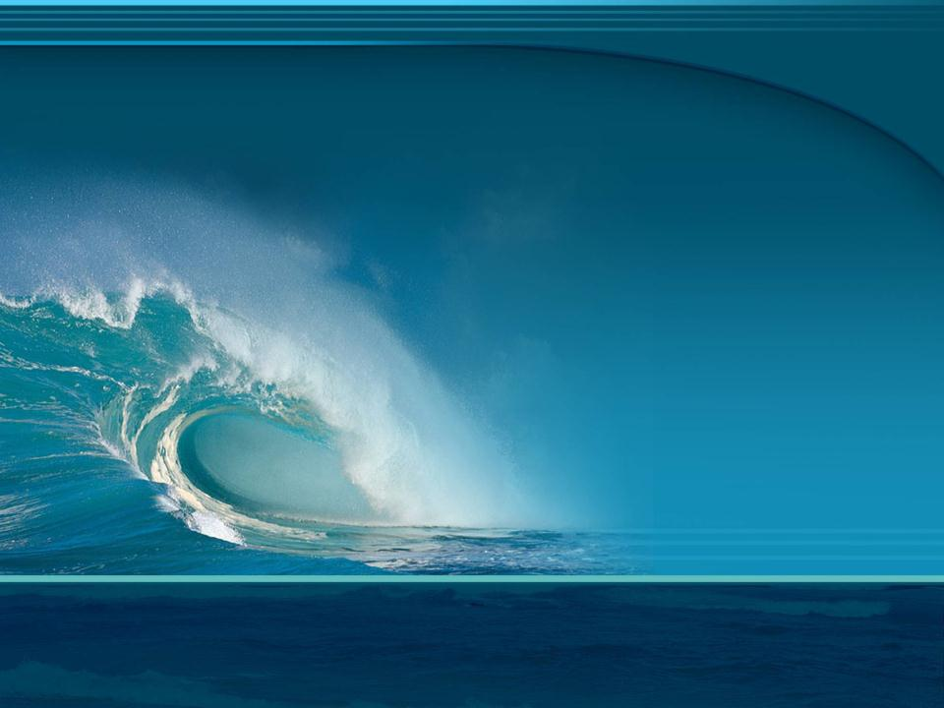
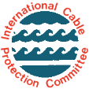
Title
About
Submarine Power Cables
Issue Date: November 2011
© 2006-2011 International Cable Protection Committee Ltd
© International Cable Protection Committee Ltd

Slide 2
Contents
Role of Submarine Power Cables
A Brief History
How Submarine Power Cables Work
Installing a Submarine Power Cable
Submarine Power Cables and the Law
Submarine Power Cables and the Environment
Other Seabed Users
Submarine Power Cables and the Future

Slide 3
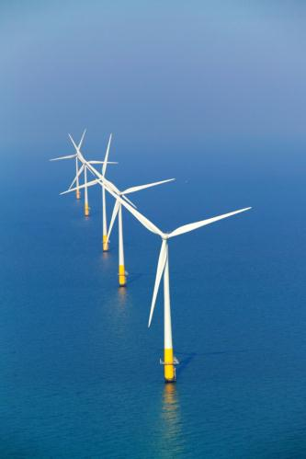
Role of Submarine Power Cables
Historically, submarine power cables linked shore-based power grids across bays, estuaries, rivers, straits, etc
Now submarine cables carry power between countries and to offshore installations, e.g. oil/gas platforms and ocean science observatories
Submarine cables also transfer power from offshore renewable energy schemes to shore, e.g. wind, wave and tidal systems
Offshore wind farm, Kentish Flats, UK Source: ELSAM Denmark

Slide 4
Importance of Power Cables
Power transfer from energy sources, including offshore renewable energy schemes, to consumers
Interconnecting different regional electrical transmission networks to allow global trading of energy
Supply to remote areas
Power (and communications) for offshore installations
With growing reliance on offshore-based renewable energy schemes, many countries now class submarine power cables as critical infrastructure
Submarine power cables are designed to be resilient, however faults can temporarily affect supply

Slide 5
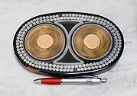
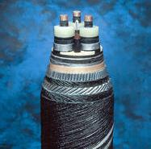
A Brief History
1811: 1st submarine power cable installed in Germany, insulated with natural rubber
1924: Lead extrusion introduced as a water barrier
1937: 1st synthetic insulation cable - butyl rubber
1952: Introduction of oil-filled insulation
1954: 1st Submarine HVDC Cable installed between Gotland and Västervick (Sweden) - 98 km long
1962: 1st ethylene-propylene rubber (EPR) insulation
1973: 1st cross linked polyethylene (XLPE) insulation
1990’s: Oil-filled insulation mostly abandoned and replaced by plastics
Modern HVDC cable Source: ABB
Note: See Glossary for explanation of above terms
Modern HVAC cable with fibre optic telecom cable (arrow) Source: ABB

Slide 6
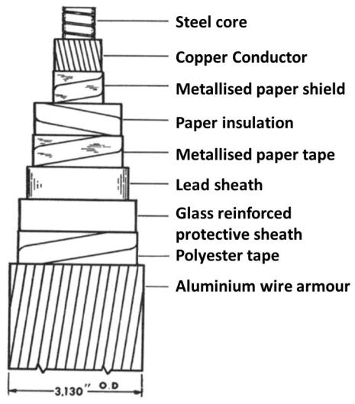
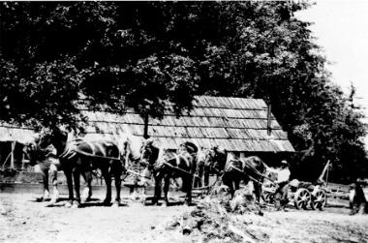
Early Submarine Power Cable
Horses pulling submarine power cable ashore to form terminal, around 1930; Washington, USA Source: Kingston Community News
115kV single conductor submarine power cable - 1962
Source: IEEE

Slide 7
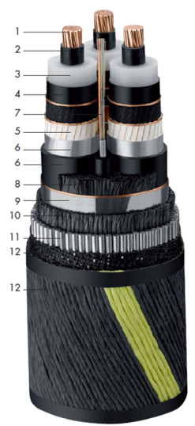
Modern Submarine Power Cable
Conductor – usually copper
Conductor screening – usually extruded
Insulation – XLPE or EPR
Insulation screening – semi-conductive
Screen
Laminated sheath – aluminum tape and polyethylene
Optical fibres – optionally used for telecommunications
Fillers – as needed
Binder tapes
Armour Bedding – polypropylene strings
Armour – galvanized round steel wires
Serving – bituminous compound, hessian tape with polypropylene coloured stripe
Construction varies with manufacturer and seabed conditions, with more armour added where, for example, waves and currents are strong
Source: Nexans

Slide 8
Power Cable Types
Two basic types of cable:
HVAC (High Voltage, Alternating Current) is limited by transmission distance, normally less than 80km
HVDC (High Voltage, Direct Current) used for longer distances and for system interconnection. AC is converted to DC for transmission through the cable and back to AC at the other end
Two basic types of insulation:
Paper insulated and fluid filled (often includes lead sheath for water blocking)
Extruded plastic insulation (XLPE or EPR)

Slide 9
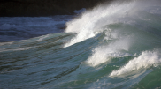
How Power Cables Work
HVAC Cables: Alternating Current transmitted down each of three conductors
HVDC Cables: Direct Current transmitted down a primary conductor and requires a return path provided via another conductor or via seawater using an anode/cathode
Note: Communications within a power cable system are often achieved by the inclusion of a fibre-optic package to carry the laser light signals. For more information about fibre-optic submarine cables please refer to “About Submarine Telecommunications Cables” on the ICPC website.

Slide 10
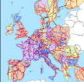


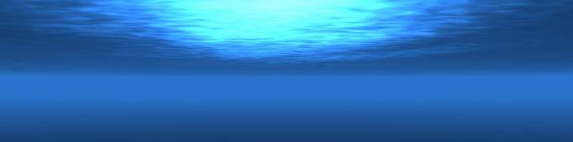
Typical Submarine Power Cable System
Network
Management
Cable links with other
Terminus, (e.g. an island) or renewable energy system (wind, wave, tide), oil /gas platform, ocean observatory
Armoured
Cable
Shore
Station
Joint
Grid
Connection
NOT TO SCALE
Source: UK Cable Protection Committee, Alcatel-Lucent Submarine Networks and Guernsey Electricity

Slide 11

Cable Size
Middle range of
oil/gas pipeline
diameters
(600 mm)
Power cable diameters are up to 300 mm depending on current-carrying capacity and amount of armour protection
Submarine oil/gas pipes can reach 1500 mm diameter, whereas submarine telecommunications cables are 17-50 mm diameter depending on armour
Submarine power cable (150 mm)
Inshore
submarine
fibre-optic
cable (50 mm)
www.iscpc.org

Slide 12
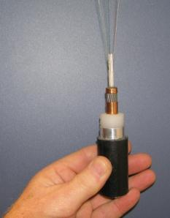
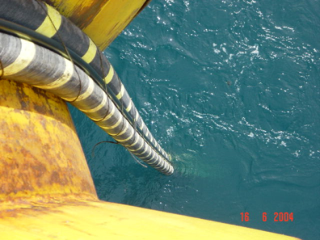
Cable Weight
Deep-sea fibre-optic cable, sectioned to show internal construction; fine strands at top are optical fibres used to transmit data
Source: L.Carter
Source: Basslink
Telecommunications cables weigh from 0.7 kg /metre for unarmoured deep-water types (example shown above left) to 4.8 kg/m for cables with two layers of steel armour protection
Power cables weigh up to 140 kg/m depending upon type
The picture (above right) shows the composite or “bundled” system of one fibre-optic cable and two power cables, together weighing 67 kg/m, being laid onto the seabed

Slide 13
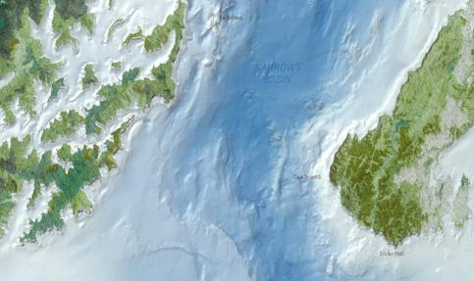
Coastal Cable Routes
To reduce risk, cables and protection zones are identified on nautical charts
A cable protection zone is a legal entity where activities harmful to cables are banned
Cable burial in water depths up to 2000 m is also a key protective measure
Effective policing of zones is essential
Cook
Strait
Cable Protection Zone
Cable Protection Zone that contains power and communications cables between the North and South islands of New Zealand
Source: NIWA and Transpower, NZ

Slide 14
Installing a Submarine Cable
Installing a submarine cable typically involves:
  Selection of provisional route
  Obtaining permission from the relevant authorities
  Full survey of route and its final selection
  Design cable system to meet conditions of selected route
  Laying the cable, including burial in appropriate areas
  In some cases, a post-lay inspection may be necessary
  Notification of cable position to other marine users

Slide 15
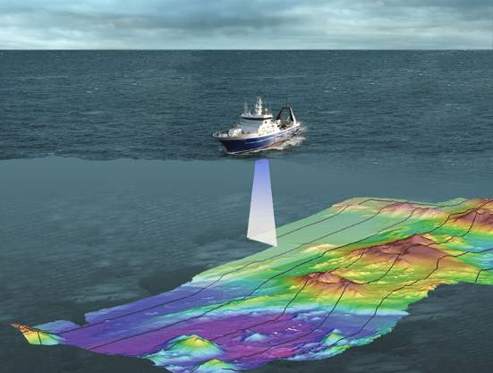
Cable Route Survey
Cable routes are carefully surveyed and selected to minimize environmental impacts and maximize cable protection
Seabed mapping systems accurately chart depth, topography, slope angles and seabed type
Source: NIWA

Slide 16
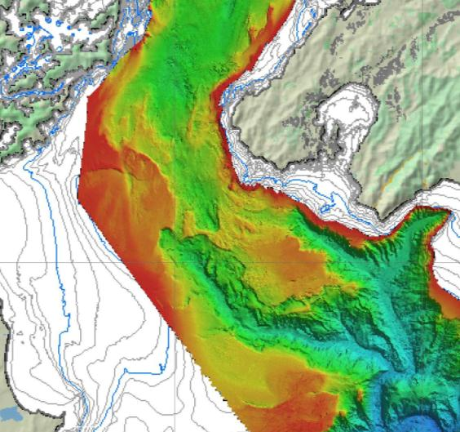
Cable Route Chart
Cook
Strait
Detailed “Multibeam” chart showing depth and topography of seabed
Used to plan the main route for submarine power and telecommunications cables across Cook Strait within the Cable Protection Zone (CPZ)
  red = < 100m deep
  blue = >1000m deep
o
o
o
o
o
o
CPZ
Source: Transpower NZ, Seaworks NZ and NIWA

Slide 17
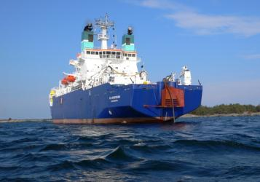
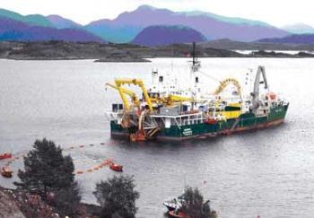
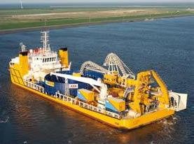
Cable Laying Vessels
CS Sovereign installing HV interconnector
Source: Global Marine Systems Ltd
CS Skagerrak installing 420 kV Cable
Source: Nexans
CLV Team Oman
Source: ABB

Slide 18
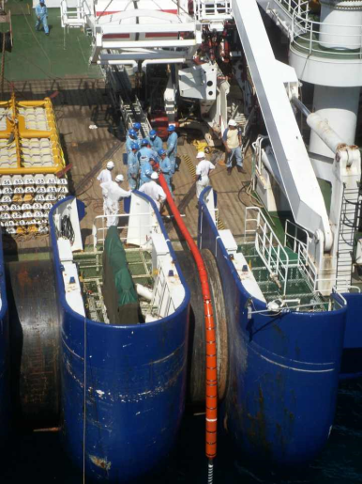
Cable Laying - 1
Purpose built ships and barges accurately place cables on or beneath the seabed, guided by the route survey
Power cables are much larger than fibre-optic telecom cables, therefore a differently equipped cable ship is required for their installation
Divers may be used to assist installation in shallow water
Deep water laying may involve Remotely Operated Vehicles (ROVs)
Power cable laid over the stern sheaves of a cable ship
Source: Global Marine Systems Ltd

Slide 19
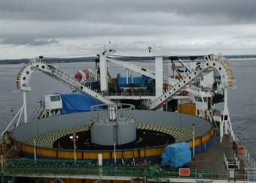
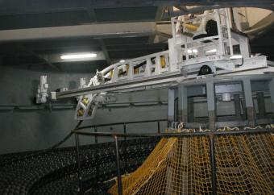
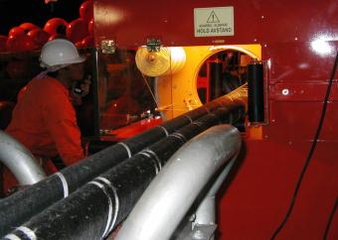
Cable Laying - 2
Power cable storage tank
on laying ship
Source: Center Marine
Loading/unloading arm in cable storage tank
Source: Global Marine Systems Ltd
“Bundling” power cables for laying Source: Global Marine Systems Ltd

Slide 20
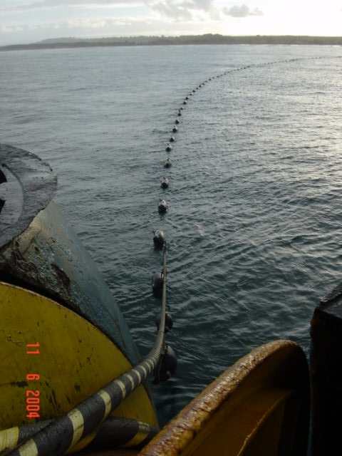
Cable Laying - 3
As a cable comes ashore it may be suspended by floats and guided into position by small boats and divers
Floats are detached or deflated and the cable is placed in its final position as determined by the route survey, which in very shallow water may be undertaken by divers
Picture on left shows the Basslink cable, which connects the Australian mainland to Tasmania, coming ashore suspended by floats to allow guidance into its final position
Source: Basslink

Slide 21
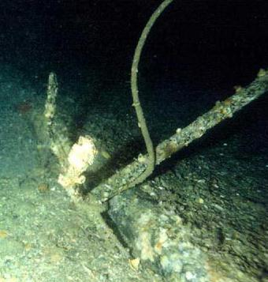
Cable Repairs
Repair of damaged power cables require specialist ships and cable jointing experts to replace the damaged section with new cable
Completion of a repair can take anything from a few days to a few weeks, depending on the extent of the damage, location of the fault and time it takes to mobilise a suitably equipped ship
A damaged submarine power cable can impact the supply of essential services over a wide area
A fishing grapnel snagged on a power cable
(which fortunately escaped major damage this time)
Source: Transpower NZ and Seaworks

Slide 22
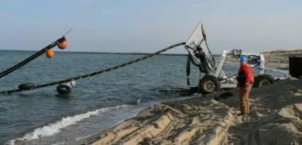
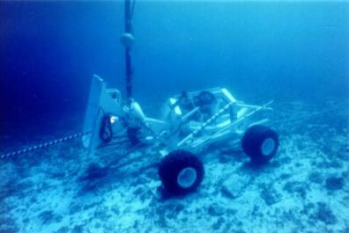
Cable Burial - 1
Cables may be buried in a narrow (<1 m wide) trench cut by water jet or plough
The plough lifts a wedge of sediment so that the cable can be inserted below
Average burial speed is around 0.2 km/hr, dependent on cable type and seabed conditions
Power cable installation using Hydroplow
Power cable installation using Hydroplow
Sources: Center Marine

Slide 23
Cable Burial - 2
Cables are typically buried 1 m and exceptionally up to 10 m beneath the seabed to protect against trawl fishing, anchoring and other activities
Multiple cables in the same area are typically buried some distance apart from each other to allow for safe maintenance
Burial may locally disrupt the seabed along a narrow path and form turbid water. The extent of this is dependent upon burial technique, seabed type and wave/current action
In the absence of cable-based studies, analysis of seabed disturbance from fishing and other activities suggests that impacts are short-lived (months) where waves/currents are active, but possibly longer-lived in deeper, less turbulent water

Slide 24
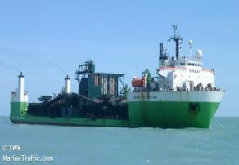
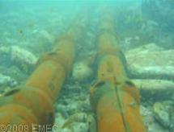

Other Protection Options
Burial is not always possible, especially in rocky areas
Alternate methods to protect cable include:
  Rock placement
  Articulated pipe
  Concrete mattress
Periodic surveys are required to check that cable remains secure
Rock Placement Vessel
Source: Marine Traffic
Articulated Pipe
Source: EMEC
Concrete Mattress
Source: Found Ocean

Slide 25
Cables and the Law - 1
Recognizing the value to humanity of national and international cables (communications and power), submarine cables are protected by international treaties:
1884: The International Convention for the Protection of Submarine Cables
1958: The Geneva Conventions of the Continental Shelf and High Seas
1982: United Nations Convention on Law of the Sea (UNCLOS)

Slide 26
Cables and the Law - 2
Modern international law extends the special status of international cables to all uses:
          Telecommunications
          Power
          Scientific
          Military

Slide 27
Cables and the Law - 3
The international treaties establish universal norms:
  Freedom to lay, maintain and repair cables outside of a nation’s
  12 nautical mile territorial sea
  National obligations to impose criminal and civil penalties for intentional or negligent injury to cables
  Special status for ships laying and repairing cables
  Indemnification for vessels that sacrifice anchors or fishing gear to avoid injury to cables
  Obligations of cables crossing earlier laid cables and pipelines to indemnify repair costs for crossing damage
  Universal access to national courts to enforce treaty obligations

Slide 28
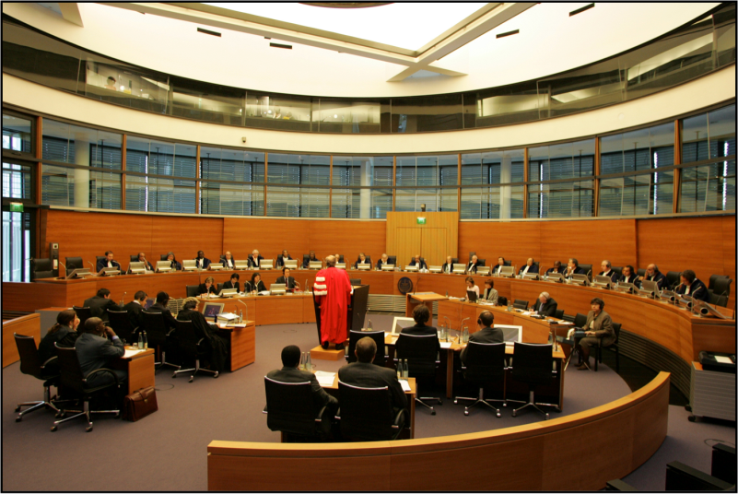
Cables and the Law - 4
The International Tribunal for the Law of the Sea, Hamburg, Germany
Source: Stephan Wallocha

Slide 29
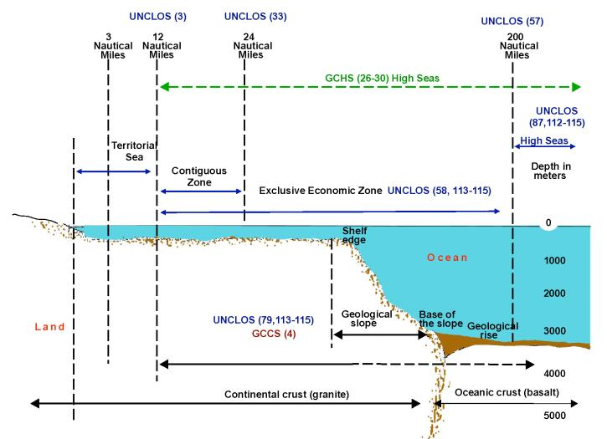
Cables and the Law - 5
Legal boundaries of the ocean from Territorial Seas to Exclusive Economic Zone and onto the High Seas Note: The numbers in (brackets) refer to treaty articles
Source: Doug Burnett

Slide 30
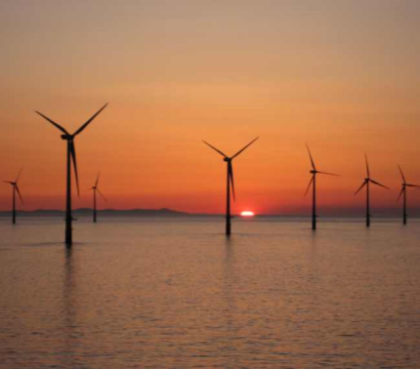
Power Cables and Renewable Energy
Under UNCLOS, cables directly involved in offshore wind and other renewable energy production are subject to exclusive coastal state jurisdiction
Although permission from a coastal state is not required to lay and maintain a submarine power transmission cable outside of its territorial seas, such permission is required if the power cable is to be used for production of energy from waves, currents and winds
Offshore wind farm
Source: Global Marine Systems Ltd

Slide 31
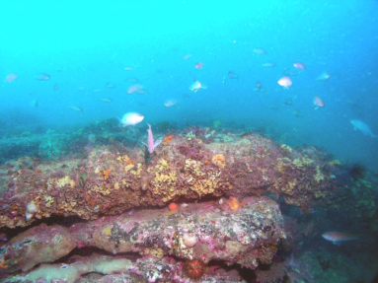
Power Cables and Environment
Power cables to remote areas and islands have been in place since early the 1800’s
Electromagnetic fields vary, depending upon cable design
Professionally installed cables have a benign association with the marine environment
Cable burial may affect marine life in a narrow corridor, but disturbance is temporary and recolonisation follows
Surface laid cables provide substrates for marine organisms
Studies of sediment-dwelling animals, both near and distant from cables, show no differences in abundance or type
Taken 4 years after installation, this picture
shows the Basslink submarine power cable in its articulated pipe (arrows) which is coated with a rich encrustation of marine life
Source: CEE Consultants and Basslink

Slide 32
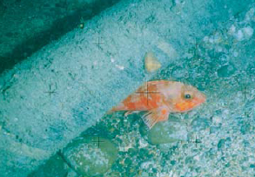
Cable Protection Zones as Sanctuaries
Zones that are created to protect submarine cables could act as marine sanctuaries, thus improving biodiversity and fish stocks
To be effective for this purpose, a protection zone must:
  contain habitats that are suitable for fish and other marine life
  exist long enough for ecosystems to develop
  be policed to prevent
  illegal fishing
126mm diameter power cable in Submarine Cable Protection Zone across Cook Strait, NZ Source: Transpower NZ

Slide 33
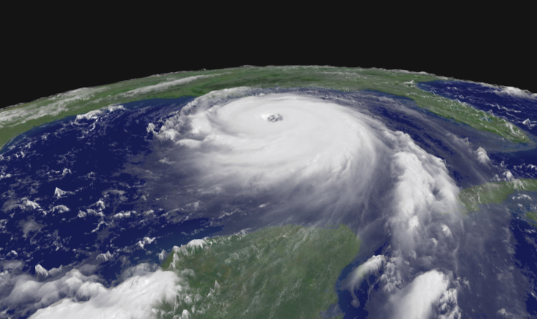
Effects of Natural Hazards - 1
Damage to submarine cable is mainly caused by human activities, less than 10% of cable faults are due to natural hazards
A major hurricane like Katrina can endanger cables by creating submarine landslides,
strong ocean currents that erode the seabed, and storm surges that flood coastal facilities
Source: NOAA

Slide 34
Effects of Natural Hazards - 2
Submarine cables are exposed to a range of natural hazards in all water depths and these include:
  Submarine earthquakes, fault lines and related landslides - break or bury cables
  Turbidity currents - break or bury
  Currents and waves - abrade, stress and fatigue
  Tsunami, storm surge and sea level rise - damage coastal installations
  Extreme weather (e.g. hurricanes) - break or bury
  Rarely, icebergs or volcanic activity - break or bury

Slide 35
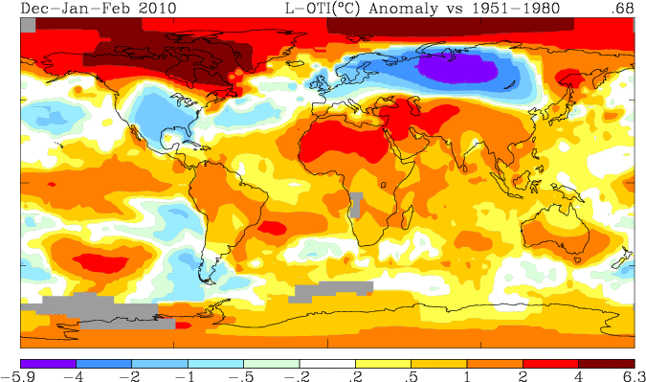
Effects of Climate Change
Cables may be exposed to risks arising from global warming, via:
Rising sea level due to thermal expansion of ocean and melting ice
Increased windiness and wave/current activity
More intense storms, rainfall and floods
Changes in offshore activities, e.g. growth of renewable energy schemes
The global distribution of temperature anomalies for winter 2010. The colder than normal winter in the USA, Europe and Russia is clear, but so is the warmer than average Arctic and much of the Southern Hemisphere. This helped make 2010 the joint warmest year on record. The scale is degrees cooler/warmer than the 1951-1980 average temperature.
Source: Goddard Institute of Space Studies, NASA

Slide 36
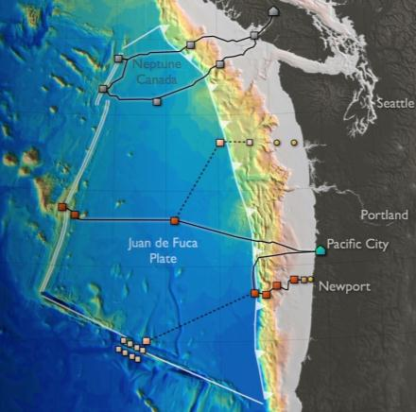
Other Seabed Users
Telecommunications cables laid throughout the world’s oceans and spanning all depths
Bottom trawl fisheries extending up to 2000 m water depth
Harvesting of minerals and hydrocarbons
Marine protected areas
Ocean science observatories
ICPC strongly supports constructive interaction with other seabed users to ensure harmonious access to coastal seas and ocean
Neptune Canada
Proposed
NW USA Observatories
Neptune Canada and US ocean observatories
with main sensor sites (grey, red, yellow shapes)
Source: University of Washington

Slide 37
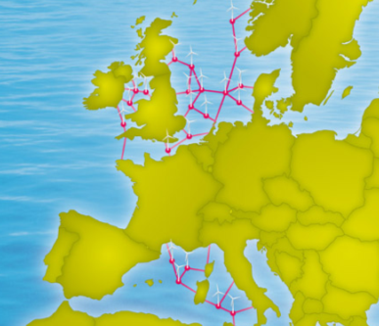
Power Cables and the Future - 1
To secure supply, meet greater demand and reduce greenhouse gas emissions, nations are turning to offshore renewable energy schemes involving wind, wave and tidal generation.
Some test and working schemes:
European Marine Energy Centre (wave and tidal energy test site)
Galway Bay (wave energy test site)
Thanet Wind Farm (300MW existing wind farm)
Wave Hub (wave energy test site)
Conceptual European SuperGrid
with selected renewable energy test sites
Source: Friends of the SuperGrid

Slide 38
Power Cables and the Future - 2
LEGAL
The ICPC is very concerned about:
Coastal State encroachment on traditional freedoms under UNCLOS to lay, maintain and repair international cables
Resolution of Continental Shelf boundaries under UNCLOS
Lack of national legislation to implement UNCLOS obligations to protect international cable infrastructure beyond territorial waters
Restrictions on international cables that are imposed without any scientific basis to appease local constituencies, some of which regard submarine cables as an alternative revenue source

Slide 39
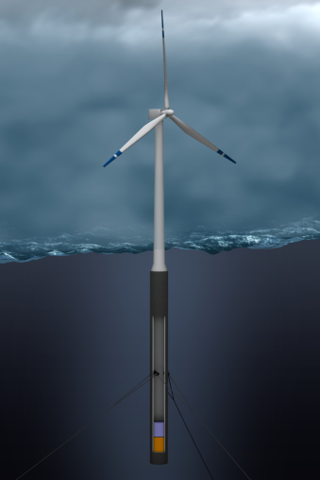
Power Cables and the Future - 3
TECHNOLOGY
Cable design and operations are constantly evolving. Future systems are expected to have greater capacity, reliability and be sited in deeper water
Longer cable routes are proposed from nations that have surplus energy, e.g. Iceland to Europe
Offshore wind farms and oil/gas platforms will extend further offshore
Wave and current/tidal power generation techniques are rapidly gaining interest throughout the World
Hywind floating wind turbine can be moored in water depths up to 700m
Source: Statoil

Slide 40
Power Cables and the Future - 4
ENVIRONMENT
In some regions of the world, submarine cables are likely to be exposed to more natural hazards related to changing climate
Climate change may also affect other marine activities such as fishing, with potential impacts on cables
Electromagnetic field studies are on-going to determine any effects of power cables on marine life
Measures to preserve biodiversity, ecosystems and resources via various protection zones in national waters and the high seas, may impinge upon cable passage
The ocean, especially the coastal seas, will be subject to increased human activities due to expansion of renewable energy schemes

Slide 41
Points of Interest
Longest HVAC submarine cable, 104 km, installed from Isle of Man to mainland England, 1999/2000
Longest HVDC cable, 580 km, installed between Norway and the Netherlands, 2008
Highest voltage (500kV) and largest conductor (3000 mm²), installed off Japan, 1998
Farthest offshore wind farm, 90 km off Borkum, Germany, 2011
Largest offshore wind farm, 300MW, England, installed 2010
First power-from-shore Dynamic AC cable for Floating Platform, 40MW, Norway, Gjøa Platform, installed 2010

Slide 42
Glossary
Armour: steel wires around cable for strength and protection
EPR: Ethylene-propylene rubber, a dielectric developed in the 1950s and used for insulation of submarine power cables
Gutta percha: a naturally occurring resin, similar to rubber, used to insulate cables up to 1930s
HVAC: High voltage alternating current for a multidirectional flow of electric charge (type of power delivered to buildings and homes for conventional use)
HVDC: High voltage direct current for a unidirectional flow of electric charge (type of power typically delivered by batteries)
Fibre-optic cable: Single conductor cable with a fibre optic core used for communications
XLPE: Cross linked polyethylene, a plastic developed in 1930s and used for submarine power cable insulation

Slide 43
Contacts
Technical Content and General Enquiries:
Email: general.manager@iscpc.org
Historical and Environmental Content:
Professor Lionel Carter
Email: lionel.carter@iscpc.org
Legal Content:
Mr. Doug Burnett
Email: doug.burnett@iscpc.org
Compiled by Jennifer Snyder and Neil Rondorf (SAIC)

Slide 44
Acknowledgements
Alcatel Submarine Networks
ABB
Basslink
Center Marine
LM Glasfiber
Elsam
European Marine Energy Centre
Found Ocean
Friends of the Supergrid
Global Marine Systems Ltd
Guernsey Electricity
IEEE
JDR Cables
Kingston Community News
LD TravOcean
Marine Traffic
NOAA
NIWA
Neptune Canada
Nexans
OSPAR Commission
Statoil
Transpower NZ and Seaworks
UK Cable Protection Committee
University Washington
Wikipedia

Slide 45
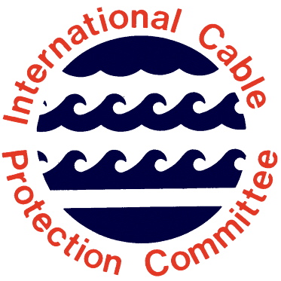
ICPC - Sharing the seabed in harmony

