Slide 1
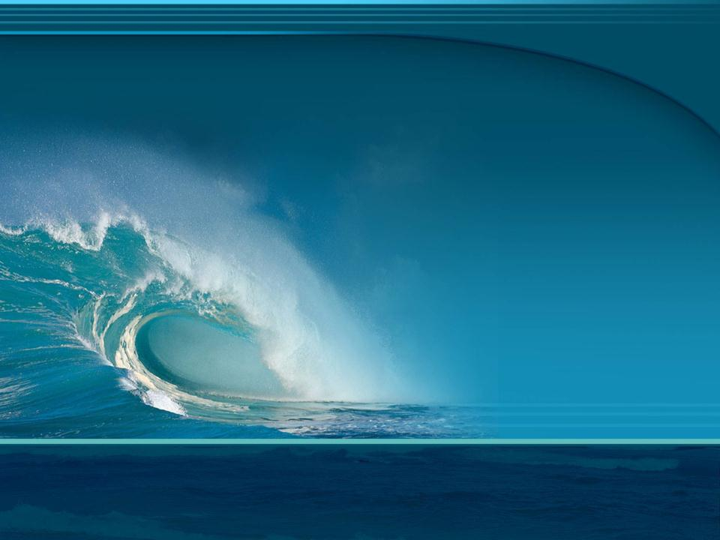
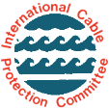
Title
About
Submarine Telecommunications Cables
Issue Date: October 2011
© 2006-2011 International Cable Protection Committee Ltd

Slide 2
Contents
A Brief History
How Submarine Cables Work
Submarine Cables and Satellites
Installing a Submarine Cable
Submarine Cables and the Law
Submarine Cables and the Environment
Effects of Human Activities
Submarine Cables and the Future

Slide 3
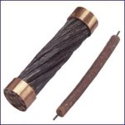
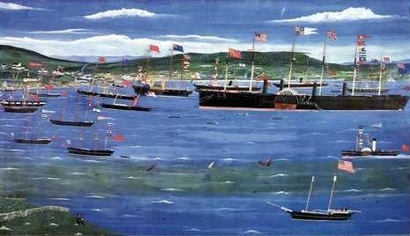
A Brief History – 1
1840: Telegraph cables start to be laid across rivers and harbours, but initially had a limited life
1843-1845: Gutta-percha (a type of gum found in a Malaysian tree) was brought to Britain and starts to replace other materials that were used for electrical insulation, thus extending the life of the cable
1850: 1st international telegraph cable laid between UK and France, followed by a stronger cable in 1851
1858: 1st transatlantic cable laid between Ireland and Newfoundland by Great Eastern. This failed after 26 days and another was laid in 1866
A
UK-France Cables
A: 1850 B: 1851
Source: BT
B
Great Eastern off Newfoundland
Source: Cable & Wireless

Slide 4
A Brief History – 2
1884: 1st underwater telephone cable - San Francisco
to Oakland
1920s: Short-wave radio superseded cables for voice and telex traffic, but capacity limited and affected by atmosphere
1956: Invention of repeaters (1940s) and their use in TAT-1, the first transatlantic telephone cable, began an era of rapid and reliable transoceanic communications
1961: Beginning of a high quality global network
1986: 1st international fibre-optic cable connects Belgium
to the UK
1988: TAT-8, the 1st transoceanic fibre-optic cable system, connects the USA to the UK and France

Slide 5
Comparing Old and New
Early Cable Systems:
1866: 1st transatlantic cable carried telegraph messages at seven words a minute and cost £20 for 20 words
1948: Telegram cost reduced to 4 pence a word for transmission across the Atlantic
1956: 1st transatlantic telephone cable (TAT-1) initially had capacity of 36 telephone calls at a time. Each call cost US$12 for the first 3 minutes
Modern Cable Systems:
1988: 1st transatlantic fibre-optic cable, TAT-8, carried 40,000 simultaneous phone calls, 10 times that of the last copper-based telephone cable
Today, a single cable can carry millions of telephone calls, together with huge amounts video and internet data

Slide 6
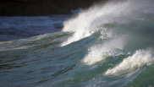

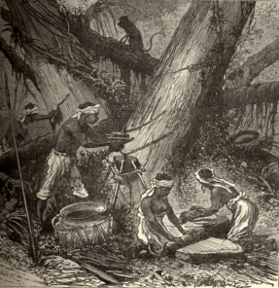
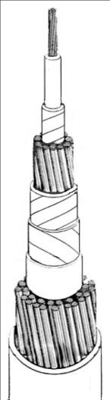
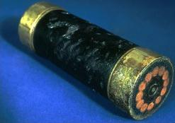
Submarine Cable – Telegraph Era
conductor - usually copper
insulation - gutta percha resin
cushioning - jute yarn
inner protection - wire armour
jute wrap to contain wire
Harvesting gutta percha resin
Source: Porthcurno Telegraph Museum
outer protection - wire armour
jute wrap to contain armour
Atlantic cable 1866
Source: Porthcurno Telegraph Museum
www.iscpc.org

Slide 7
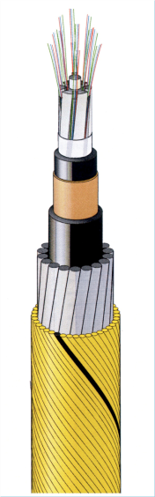
Modern Submarine Cable
optical fibres - silica glass
core for strength and fibre separation - polyethylene/fibreglass
jacket - polyethylene
conductor - copper
jacket - polyethylene
protective armour - steel wire
outer protection and wire containment - polypropylene yarn
Construction varies with manufacturer and seabed conditions
Cables may have no armour in stable, deep-ocean sites or one or more armour layers for energetic zones, e.g. coastal seas
Source: Ericsson

Slide 8
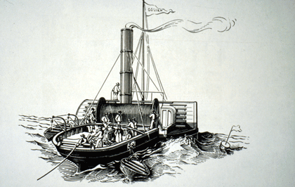
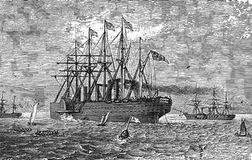
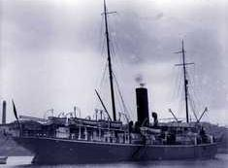
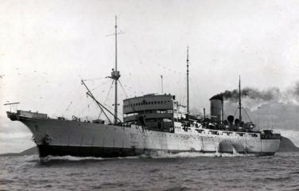
Early Cable Ships
Goliath: lays 1st international cable, UK-France, 1850-1
Source: Illustrated London News
Great Eastern: laying cable off Newfoundland, 1866
Source: Canadian Government
John Pender, named after pioneer cable maker, 1900
Source: Cable & Wireless
Monarch: laid 1st transatlantic telephone cable, 1955/6
Source: www.atlantic-cable.com

Slide 9
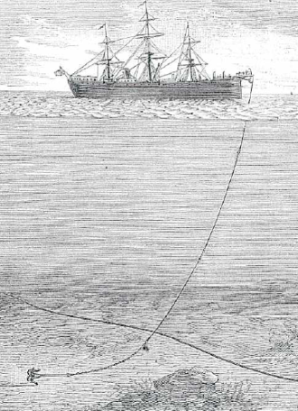
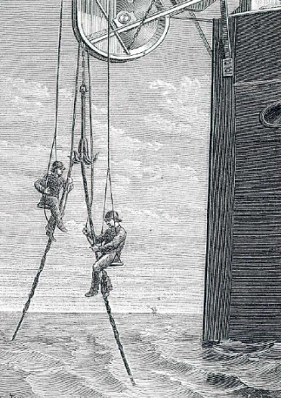
Cable Repair in 1888
A
B
[A] Cable ship trailing grapnel to retrieve cable followed by [B] securing of the cable ready for repair
Source: Traité de Télégraphie Sous-Marine by E. Wüschendorff, 1888

Slide 10
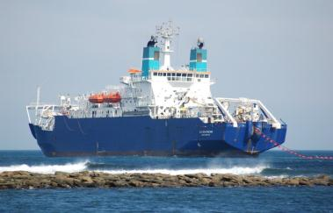
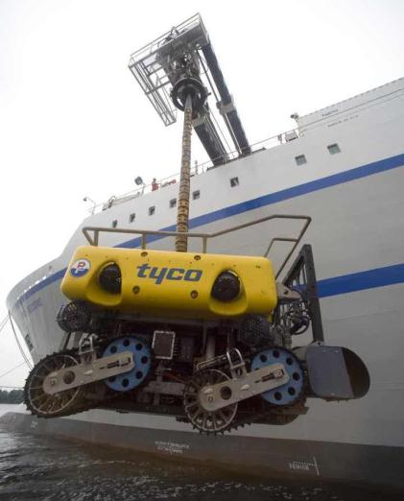
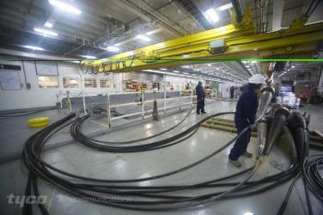
Modern Cable Handling Methods
Bringing the cable ashore
Source: Global Marine Systems
Cable and repeaters inside a cable ship
Source: TE SubCom
ROV used for cable inspection, recovery and burial
Source: TE SubCom

Slide 11
How Submarine Cables Work
Fibre-optic submarine cables rely on a property of pure glass fibres whereby light is guided by internal reflection
Because the light signal loses strength en route, repeaters are required at regular intervals to restore it
Repeaters are now based on optical amplifying technology, which requires short lengths of erbium-doped optical fibre to be spliced into the cable system. These are then energized by lasers that cause them to ‘lase’, thus boosting the incoming light signal

Slide 12
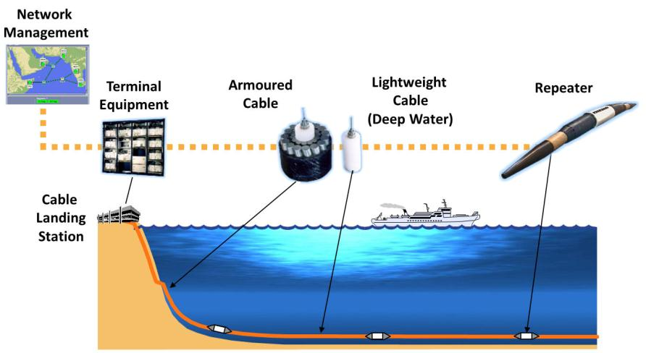
Typical Submarine Cable System
NOT TO SCALE
Source: UK Cable Protection Committee and Alcatel-Lucent Submarine Networks

Slide 13
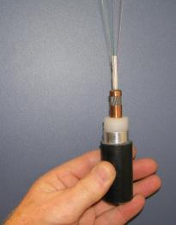
Cable Size
Cables are small: deep-ocean types, without protective armour, are typically 17-20 mm diameter – the size of a garden hose or beer bottle cap
Armoured fibre-optic cables may reach 50 mm diameter
In contrast, submarine oil/gas pipes can reach 900 mm diameter, and fishing trawls typically range over 5,000 – 50,000 mm wide
One of the longest cable systems is the South East Asia - Middle East - West Europe 3 system (SE-ME-WE-3), with a total installed length (including branches) of almost 40,000 km
Deep-sea cable, (black) sectioned to show internal construction; fine strands at top are optical fibres used to transmit data
600 mm
oil/gas
pipe
Deep ocean
Fibre-optic
cable
Modern fibre-optic cable in hand (for scale) and relative to 600 mm diameter subsea pipe
www.iscpc.org

Slide 14
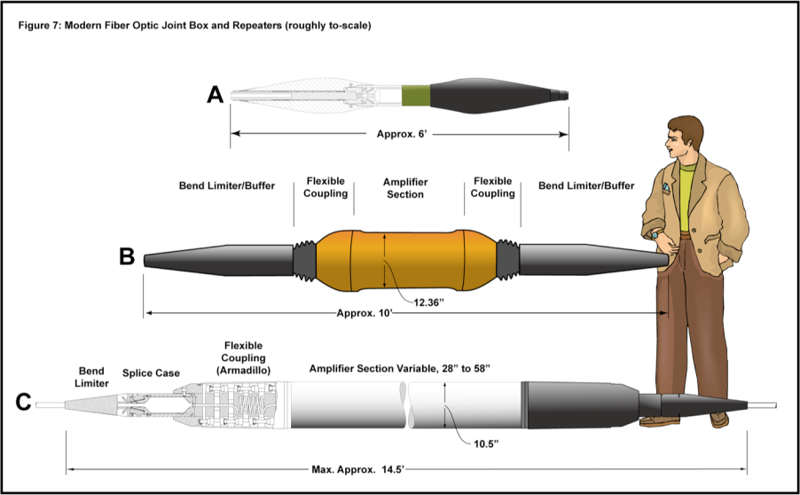
Joint Boxes and Repeaters
Source: Lonnie Hagadorn

Slide 15
Submarine Cables and Satellites
Advantages of cables
High reliability, capacity and security
Insignificant delay compared to satellite
Most cost-effective on major routes, hence rates cheaper than satellites
Carry >95% of transoceanic voice and data traffic
Advantages of satellites
Suitable for regions that are vulnerable to disasters
Provide wide broadcast coverage, e.g. for TV
Suitable for minor routes such as links between small island nations
Carry <5% of transoceanic voice and data traffic

Slide 16
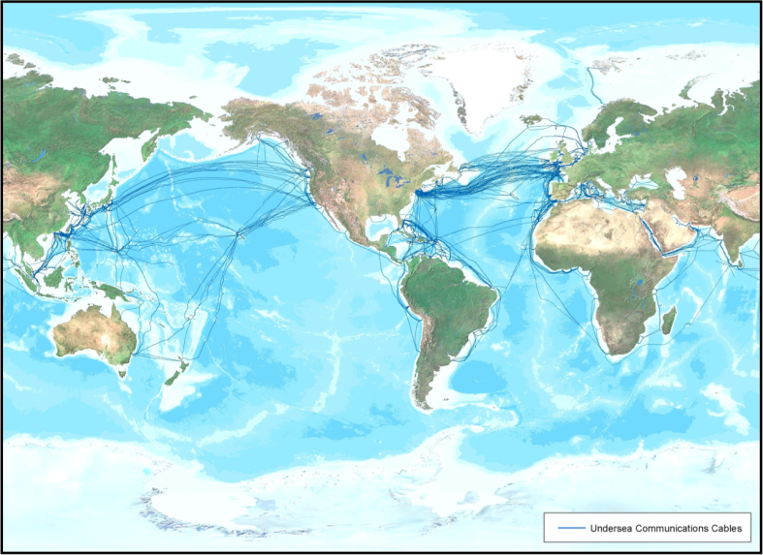
Main International Cable Routes
Submarine Communications Cables
Source: TE SubCom

Slide 17
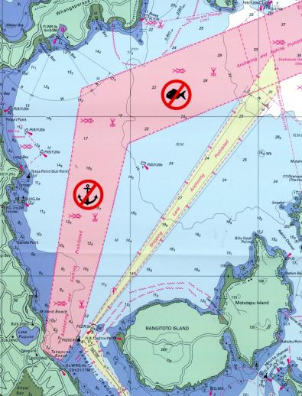
Coastal Cable Routes
Near the shore, cables need protection from shipping, fishing and other activities
To reduce risk, cables and protection zones are identified on nautical charts
A cable protection zone is a legal entity where activities harmful to cables are banned
Cable burial in water depths up to 2000 m is also a key protective measure
Chart with protection zone for Southern Cross cable terminal in New Zealand
Source: Telecom NZ

Slide 18
Installing a Submarine Cable
Installing a submarine cable typically involves:
  Selection of provisional route
  Obtaining permission from the relevant authorities
  Full survey of route and its final selection
  Design cable system to meet conditions of selected route
  Laying the cable, including burial in appropriate areas
  In some cases, a post-lay inspection may be necessary
  Notification of cable position to other marine users

Slide 19
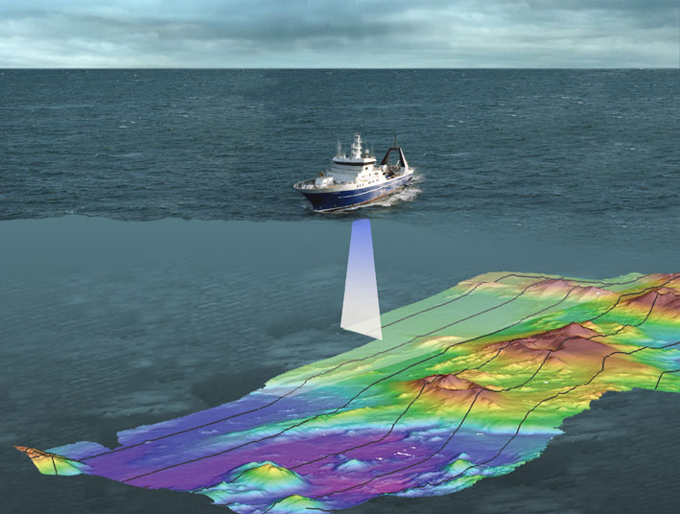
Cable Route Survey
Cable routes are carefully surveyed and selected to minimize environmental impacts and maximize cable protection
Seabed mapping systems accurately chart depth, topography, slope angles and seabed type
Source: NIWA

Slide 20

Cable Laying
Guided by the route survey, specially designed ships are used to accurately place cables on or beneath the seabed
Shallow water laying may be aided by divers ; Deep water laying may involve remotely operated vehicles
Source: Alcatel-Lucent Submarine Networks

Slide 21
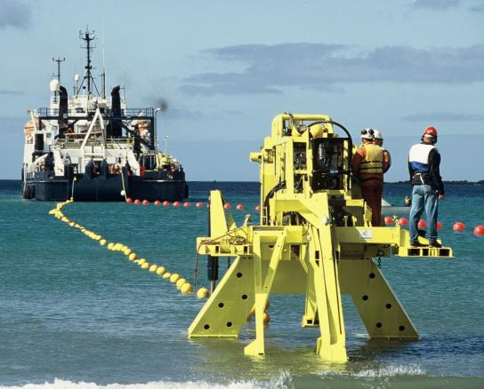
Cable Burial - 1
Cables may be buried in a narrow (<1 m wide) trench cut by water jet or plough
The plough lifts a wedge of sediment so that the cable can be inserted below
Burial speed depends on cable type and seabed conditions
For an armoured cable, the burial speed is about
0.2 km/hr
A plough being prepared to start the burial of a cable
Source: Seaworks, NZ

Slide 22
Cable Burial - 2
Cables are typically buried 1 m and exceptionally up to 10 m beneath the seabed to protect against trawl fishing, ships anchoring and other activities
Burial may extend from the shore to about 2000 m water depth, which is the present limit of trawl fisheries
Burial may locally disrupt the seabed along a narrow path and form turbid water. The extent of this is dependent upon burial technique, seabed type and wave/current action
In the absence of cable-based studies, analysis of seabed disturbance from fishing and other activities suggests that impacts are short-lived (months) where waves/currents are active, but possibly longer-lived in deeper, less turbulent water

Slide 23
Cable Repair
In the event of a fault, the cable has to be recovered from the seabed so that a replacement section can be spliced in:
Source: Alcatel-Lucent Submarine Networks

Slide 24
Cables and the Law - 1
Recognizing the value to humanity of international communications, cables are protected by international treaties:
1884: The International Convention for the Protection of Submarine Cables
1958: The Geneva Conventions of the Continental Shelf and High Seas
1982: United Nations Convention on Law of the Sea (UNCLOS)

Slide 25
Cables and the Law - 2
Modern international law extends the special status of international cables to all uses:
      Telecommunications
      Power
      Scientific
      Military

Slide 26
Cables and the Law - 3
The international treaties establish universal norms:
  Freedom to lay, maintain and repair cables outside of a nation’s
  12 nautical mile territorial sea
  National obligations to impose criminal and civil penalties for intentional or negligent injury to cables
  Special status for ships laying and repairing cables
  Indemnification for vessels that sacrifice anchors or fishing gear to avoid injury to cables
  Obligations of cables crossing earlier laid cables and pipelines to indemnify repair costs for crossing damage
  Universal access to national courts to enforce treaty obligations

Slide 27
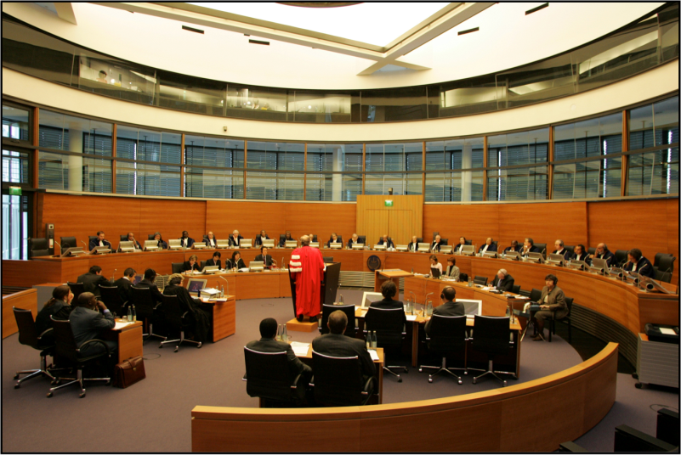
Cables and the Law - 4
The International Tribunal for the Law of the Sea, Hamburg, Germany
Source: Stephan Wallocha

Slide 28
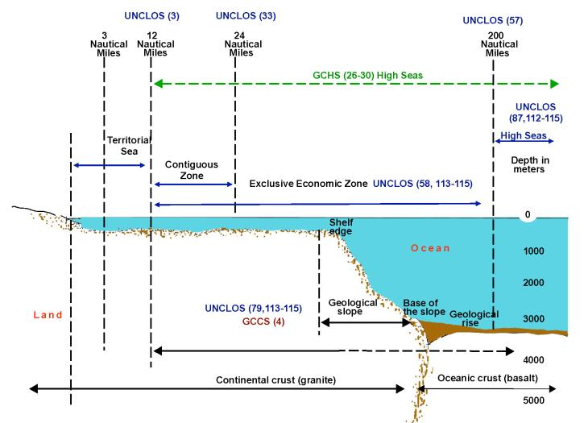
Cables and the Law - 5
Legal boundaries of the ocean from Territorial Seas to Exclusive Economic Zone and onto the High Seas Note: The numbers in (brackets) refer to treaty articles
Source: Doug Burnett

Slide 29
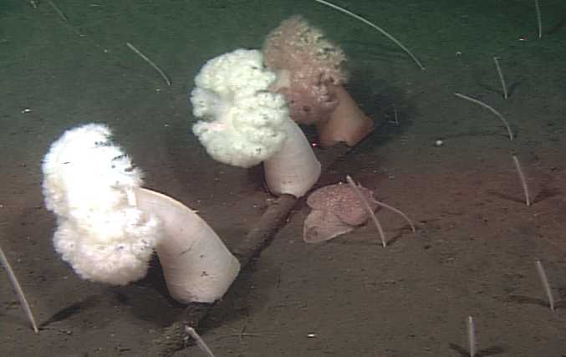
Cables and the Environment - 1
ATOC/Pioneer Seamount scientific cable with attached anemones (Metridium farcimen)
located in 140 m water depth off California
Source: Monterey Bay Aquarium Research Institute

Slide 30
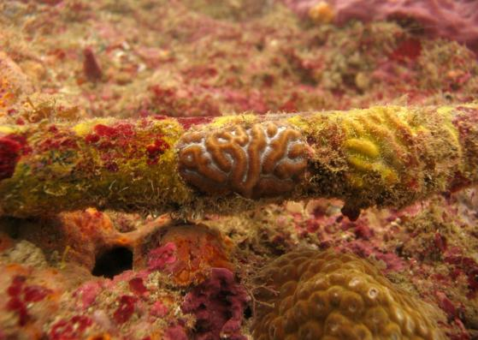
Cables and the Environment - 2
Properly laid, fibre-optic cables have a neutral to benign impact on marine environment
A cable’s small size means its “footprint” is small, especially compared to submarine pipelines or trawl dredge
Cables are substrates for marine organisms with recovered cables yielding key specimens for scientific collections
Telecommunications cable with encrusting marine organisms
Source: Glauco Rivera

Slide 31
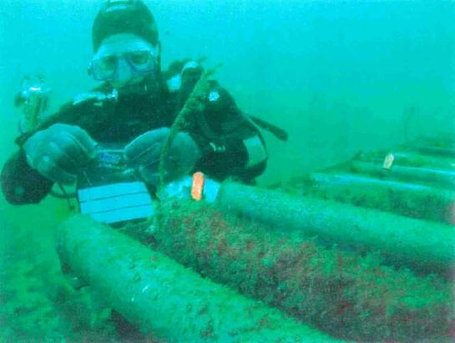
Cables as Artificial Reefs - 1
Scientific tests undertaken in the UK show that:
Cables are fully colonised by marine organisms in 1-2 months depending on conditions
Cables are essentially non-polluting
C
P
C
P
Diver checks lengths of fibre-optic cable (C) and plastic pipes (P) that act as controls to check rates of colonisation by marine organisms
Source: Dr K. Collins, Southampton University

Slide 32
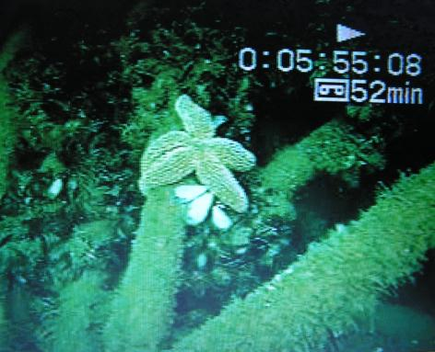
Cables as Artificial Reefs - 2
Coils of cable have been placed off Maryland and New Jersey to form artificial reefs
These reefs have attracted many marine organisms that range from algae to fish
To be successful, reefs must be stable, non-toxic, last for 20-30 years and provide habitats
Submarine cable coiled to form an artificial reef on the continental shelf off the US state of Maryland.
This picture shows colonisation by starfish, mussels and other organisms that may help biodiversity & fish stocks
Source: © Compass Light

Slide 33
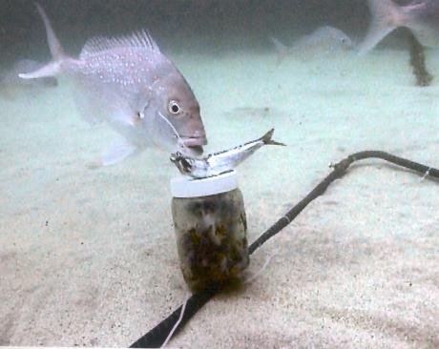
Cable Protection Zones as Sanctuaries
Zones that are created to protect submarine cables could act as marine sanctuaries, thus improving biodiversity and fish stocks
An effective zone must contain habitats that are suitable for fish and other marine life, exist long enough for ecosystems to develop and be policed to prevent illegal fishing
Experiment to count fish to test if a cable protection zone acts as a marine sanctuary
Source: Leigh Laboratory, University of Auckland

Slide 34
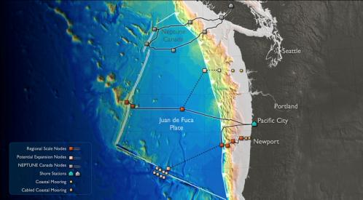
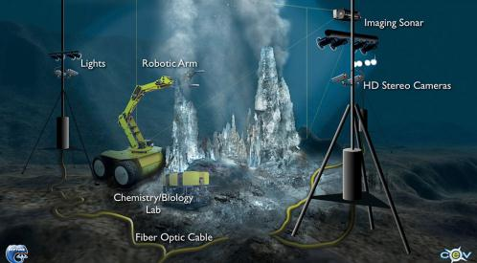
Observing the Ocean
Ocean observatories are being developed for the long-term monitoring of the marine environment
Observation sites will be linked via submarine cables that will provide power for equipment and data transfer to shore
Covering many parts of the world, observatories will help detect and warn of natural hazards, measure ocean response to climate change, undertake research and develop technologies
Observatories off Canada and USA [top] with artist’s depiction of proposed activities [bottom] Source: Neptune Canada and OOI
www.iscpc.org

Slide 35
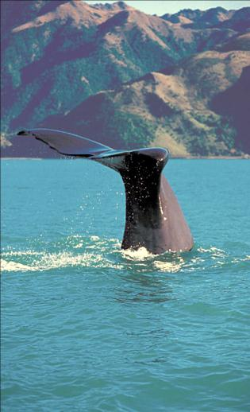
Marine Mammals
Published cable fault data show that from 1877 to around 1960, 16 whale entanglements were noted – mainly involving sperm whales
Since that period there have been no reported incidents of marine mammal entanglements
This change in part reflects improved materials and laying techniques
Compared to telegraph cables, modern cables are stronger, laid under tension with less slack, and are often buried below the seabed in water depths down to 2000 m
Sperm whale begins dive off New Zealand Source: NIWA

Slide 36
Fish (including Sharks)
Faults caused by fish restricted mainly to telegraph cables (pre-1964)
Attacks could be due to cable smell, colour, motion or electro-magnetic field
In 1985-1987, a domestic fibre-optic cable installed in the Canary Islands was damaged by sharks in 1-2 km water depth
These attacks were verified by the presence of shark teeth that were found embedded in the cable
The cable design was subsequently improved with the inclusion of metal tape sheathing in 1988
There is no evidence of faults caused by fish (including sharks) on systems that use this improved cable design

Slide 37
Effects of Natural Hazards - 1
  Submarine cables are exposed to natural hazards in all water depths
  In depths to around 1000 m, the main hazards are human activities with natural effects causing under 10% of cable damage incidents
  Natural hazards dominate in water depths greater than 1000 m. These include:
    Submarine earthquakes, fault lines and related landslides - break or bury cables
    Density currents - break or bury
    Currents and waves - abrasion, stress and fatigue
    Tsunami, storm surge and sea level rise - damage coastal installations
    Extreme weather (e.g. hurricanes) - break or bury
    Rarely, icebergs or volcanic activity

Slide 38
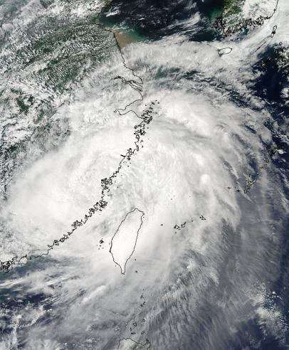
Effects of Natural Hazards - 2
Typhoon Morakot struck Taiwan from 7-11 August 2009, when almost 3 m of rain fell in the central mountains
This caused rivers to flood and carry vast amounts of sediment to the ocean
So much sediment was discharged that dense sediment-laden currents formed and flowed across the seabed, breaking several cables en route
While records of such events are too short to identify trends, the enhanced precipitation of Typhoon Morakot is consistent with warmer air and ocean temperatures
China
Taiwan
Typhoon Morakot masks Taiwan as it releases a deluge
to set off submarine mud flows that broke cables
Source: MODIS Rapid Response, NOAA

Slide 39
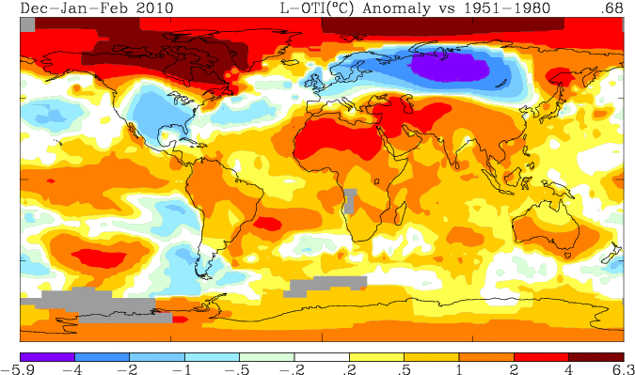
Effects of Climate Change
Cables may be exposed to risks arising from global warming via:
Rising sea level due to thermal expansion of ocean and melting ice
Increased windiness and wave/current activity
More intense storms, rainfall and floods
Changes in offshore activities, e.g. growth of renewable energy schemes
The global distribution of temperature anomalies for winter 2010. The colder than normal winter in the USA, Europe and Russia is clear, but so is the warmer than average Arctic and much of the Southern Hemisphere. This helped make 2010 the joint warmest year on record. The scale is degrees cooler/warmer than the 1951-1980 average temperature.
Source: Goddard Institute of Space Studies, NASA

Slide 40
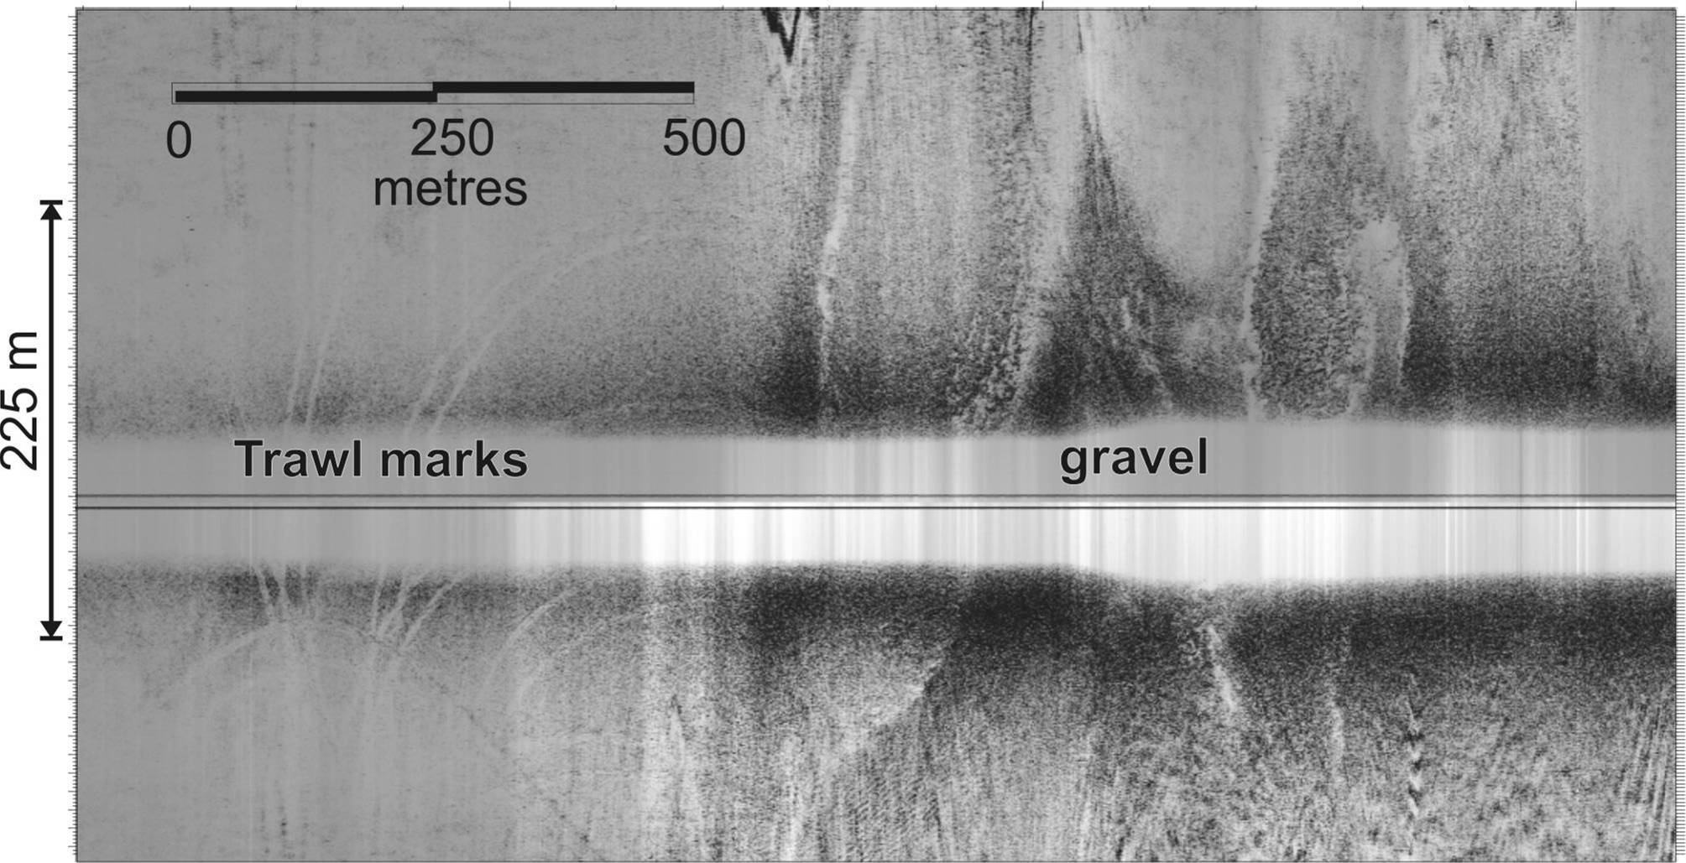
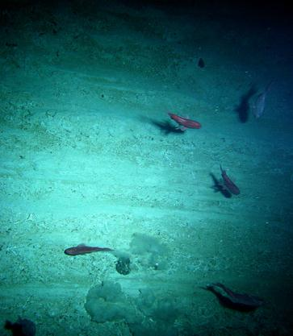
Effects of Human Activities
Submarine cables are coming into increasing contact with other seabed users, especially fishing and shipping industries
Sonar image of 25m wide trawl scars,
Nova Scotian shelf
Source: A. Orpin, NIWA
Trawl scars, Chatham Rise
Source: M. Clark, NIWA

Slide 41
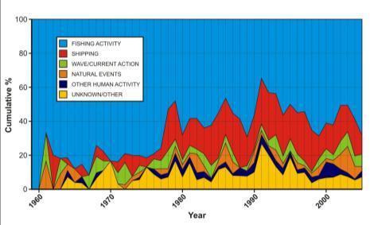
Fault Causes
External aggression faults
Year
Depth ranges (m)
Analysis of faults by type of aggression
Source: M. Wood and L. Carter, IEEE, 2008
Analysis of faults by water depth
Source: Submarine Cable Improvement Group
Around 70% of all cable faults are caused by fishing and anchoring activities
Around 12% are caused by natural hazards, e.g. current abrasion or earthquakes
Most faults are caused by human activities in less than 200 m water depth
Faults in more than 1000 m water depth are mostly caused by natural events

Slide 42
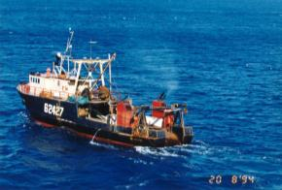
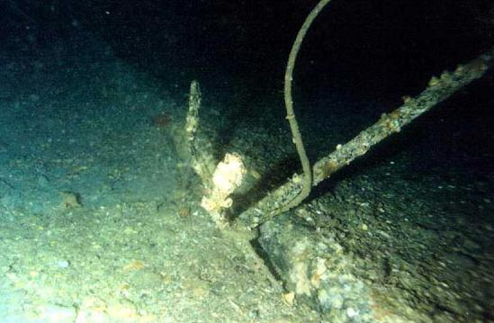
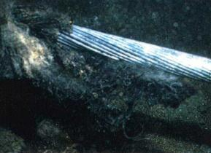
Cable Damage From Fishing
Illegal fishing in
cable protection zone
Cable snagged and moved by trawl gear
Sources: Seaworks and Transpower NZ
Cable damaged by trawl gear

Slide 43
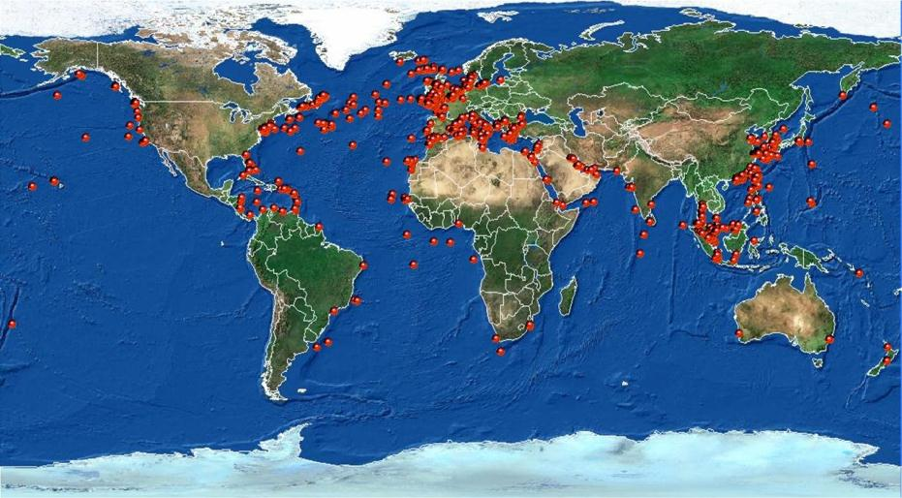
Cable Faults Worldwide
Global pattern of external aggression cable faults, 1959-2006
Source: TE SubCom

Slide 44
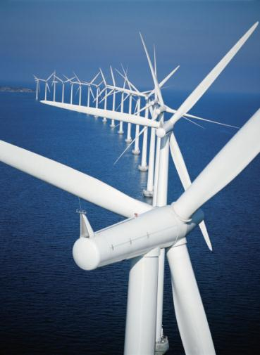
Other Seabed Users
Coastal seas are increasingly used for energy projects
(wind, tide and wave power), resource extraction and environmental protection (marine sanctuaries, marine protected areas, etc.)
ICPC strongly supports constructive interaction with other seabed users to ensure harmonious access to the coastal seas and ocean
Offshore wind farm, Middelgrunden, Denmark Source: © LM Glasfiber

Slide 45
Cables and the Future - 1
“Prediction is very difficult, especially about the future” - Niels Bohr
TECHNOLOGY
Cable design and operations are constantly evolving. New systems are smaller with greater capacity and reliability
Further development of ocean observatories will rely on new cable technology. This is likely to include integrated environmental sensors and docking modules to enable submarine survey vehicles to download data and recharge
Submarine cables, with sensors to detect chemical and physical changes, are planned for maritime and coastal defenses

Slide 46
Cables and the Future - 2
ENVIRONMENT
In some regions of the world, submarine cables are likely to be exposed to more natural hazards related to changing climate
Climate change may also affect other marine activities such as fishing, with potential impacts on cables
Measures to preserve biodiversity, ecosystems and resources via various protection zones in national waters and the high seas, may impinge upon cable passage
The ocean, especially the coastal seas, will be subject to increased human activities due to expansion of renewable energy schemes

Slide 47
Cables and the Future - 3
LEGAL
The ICPC is very concerned about:
Coastal State encroachment on traditional freedoms under UNCLOS to lay, maintain and repair international cables
Resolution of Continental Shelf boundaries under UNCLOS
Lack of national legislation to implement UNCLOS obligations to protect international cable infrastructure beyond territorial waters
Restrictions on international cables that are imposed without any scientific basis to appease local constituencies, some of which regard submarine cables as an alternative revenue source

Slide 48
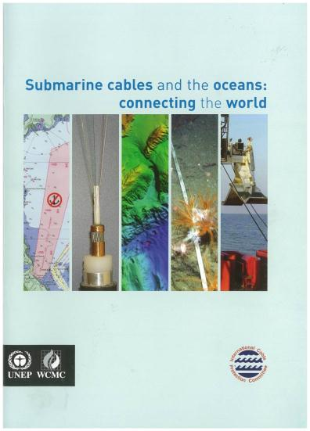
More Information
This booklet was prepared in collaboration with UNEP (United Nations Environmental Programme) and was published in 2009.
It provides an objective, factual description of the submarine cable industry and the interaction of submarine cables with the marine environment.
A copy can be downloaded by clicking here

Slide 49
Glossary
Armour: steel wires placed around cable for strength and protection
Coaxial cable: two concentric conductors separated by an insulator; enabled telephone calls over long distances using analogue technology
Fibre-optic cable: Optical fibres encased in protective tube that is also a power conductor for repeaters. Enables telephone, video and data communications over long distances using light; has much greater capacity, reliability and signal quality
Repeater: Submersible housing containing equipment that is needed to boost the signal at regular intervals on long submarine cable systems; powered from the cable terminal
ROV: Remotely Operated Vehicle – a submersible tool that works on the seabed to inspect, bury or recover the cable
Telegraph cable: Copper wires insulated with gutta-percha, wrapped in India rubber and steel wire

Slide 50
Contacts
Technical Content and General Enquiries:
Email: general.manager@iscpc.org
Historical and Environmental Content:
Professor Lionel Carter
Email: lionel.carter@iscpc.org
Legal Content:
Mr. Doug Burnett
Email: doug.burnett@iscpc.org
Presentation compiled by Lionel Carter and Doug Burnett

Slide 51
Acknowledgements
NIWA
NOAA
Porthcurno Telegraph Museum
Seaworks NZ
Southampton University
Submarine Cable Improvement Group
Telecom NZ
TE SubCom
Transpower NZ
UK Cable Protection Committee
UN Environmental Programme
University of Auckland
University of Massachusetts
Alcatel-Lucent Submarine Networks
British Telecom
Cable & Wireless
Compass Light
Ericsson
Global Marine Systems
Government of Canada
IFREMER
KDDI
LM Glasfiber
Lonnie Hagadorn
Monterey Bay Aquarium Research Institute
Neptune Canada
NASA

Slide 52
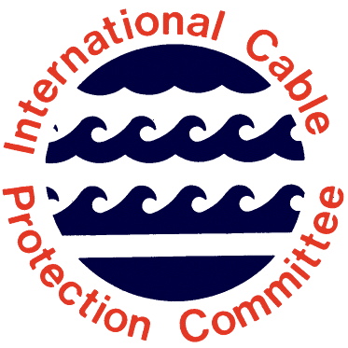
ICPC - Sharing the seabed in harmony

